Slide 1
DSCI 6007-Final Project – Showcase
Optimizing Business Operations using a Scalable Data Engineering Pipeline
04/29/2025

Slide 2



Team 10
Nischal Subedi
Team Leader
Ronik Karki
Visualization & Storytelling lead
Abhigya Malla
Data Engineer

Slide 3

Business scenario overview
Financial Losses from underperforming stores or products
Resources Wastage due to poor management
Reduced Productivity from delayed decision making
Lack of real-time insights

Slide 4
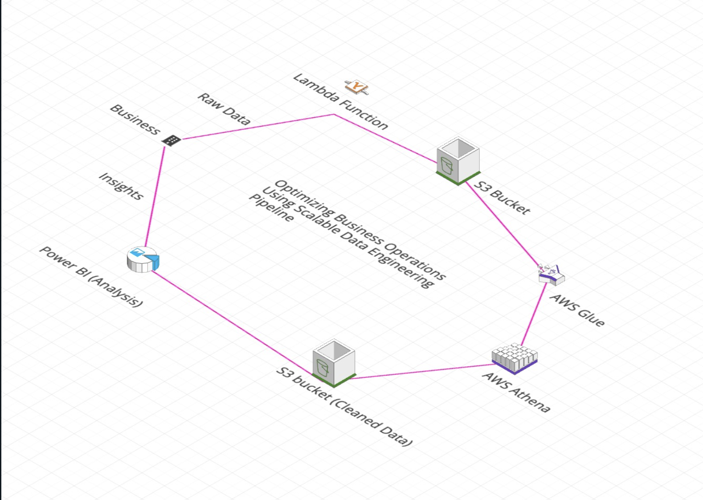
Solution overview
Cloud-based data engineering pipeline for real-time operational insights
Diagnoses inefficiencies, predicts underperformance, and informs decisions

Slide 5
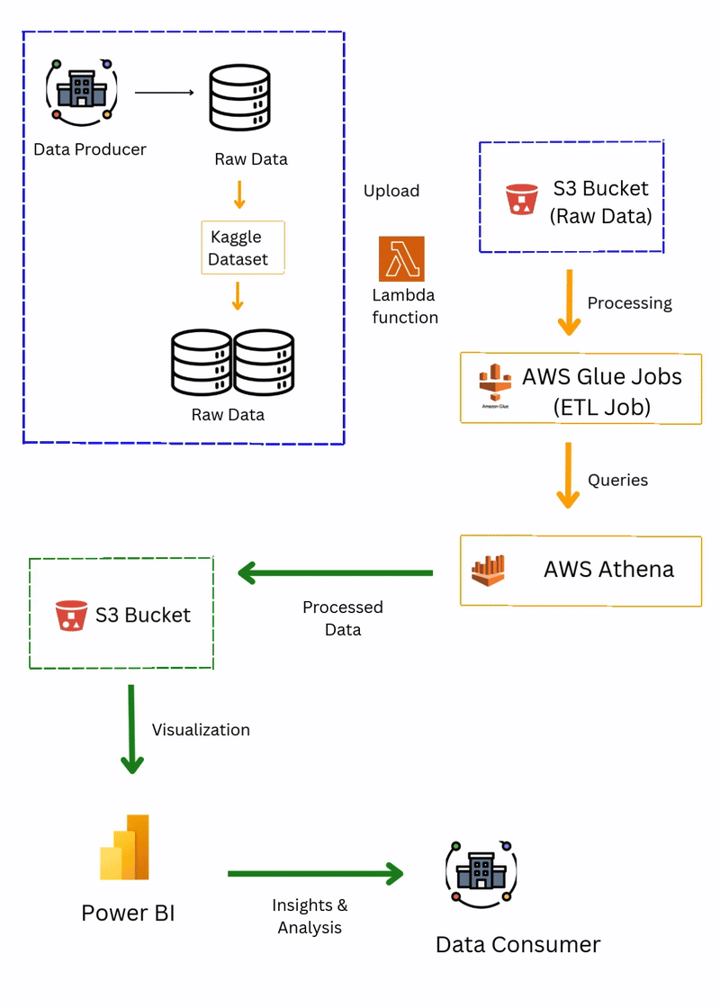
Architecture diagram

Slide 6
Lesson learned
Importance of Scalable design
Data Quality matters.
Visualizing Insights Effectively
Advantages of Cloud Based Services

Slide 7
DEMO

Slide 8
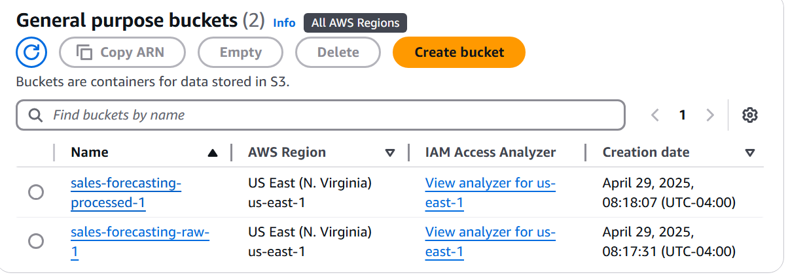
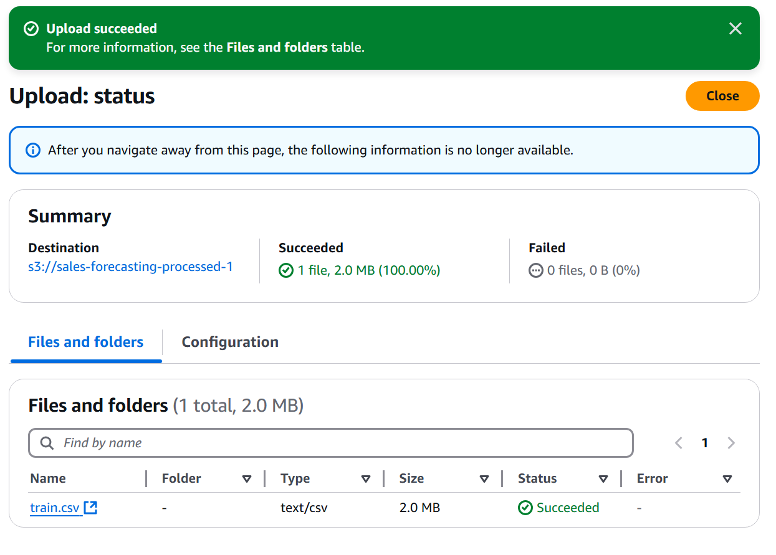
S3 Bucket Creation
Raw CSV file

Slide 9
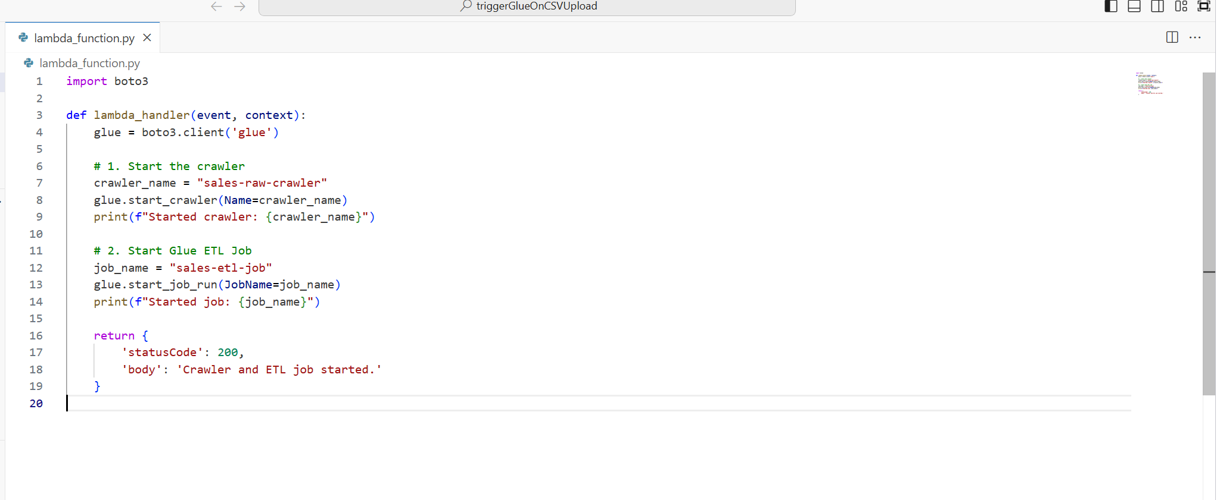
Lambda Function

Slide 10
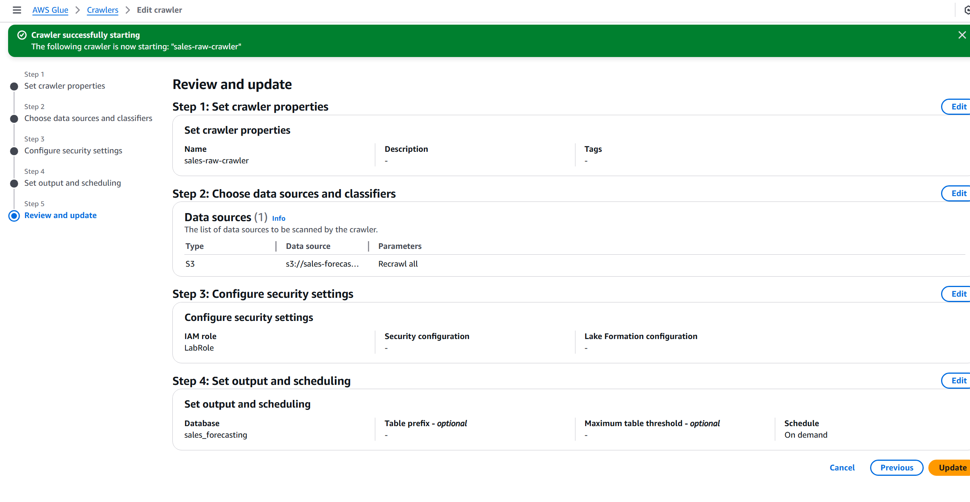
Glue ETL Job Crawler Setup

Slide 11
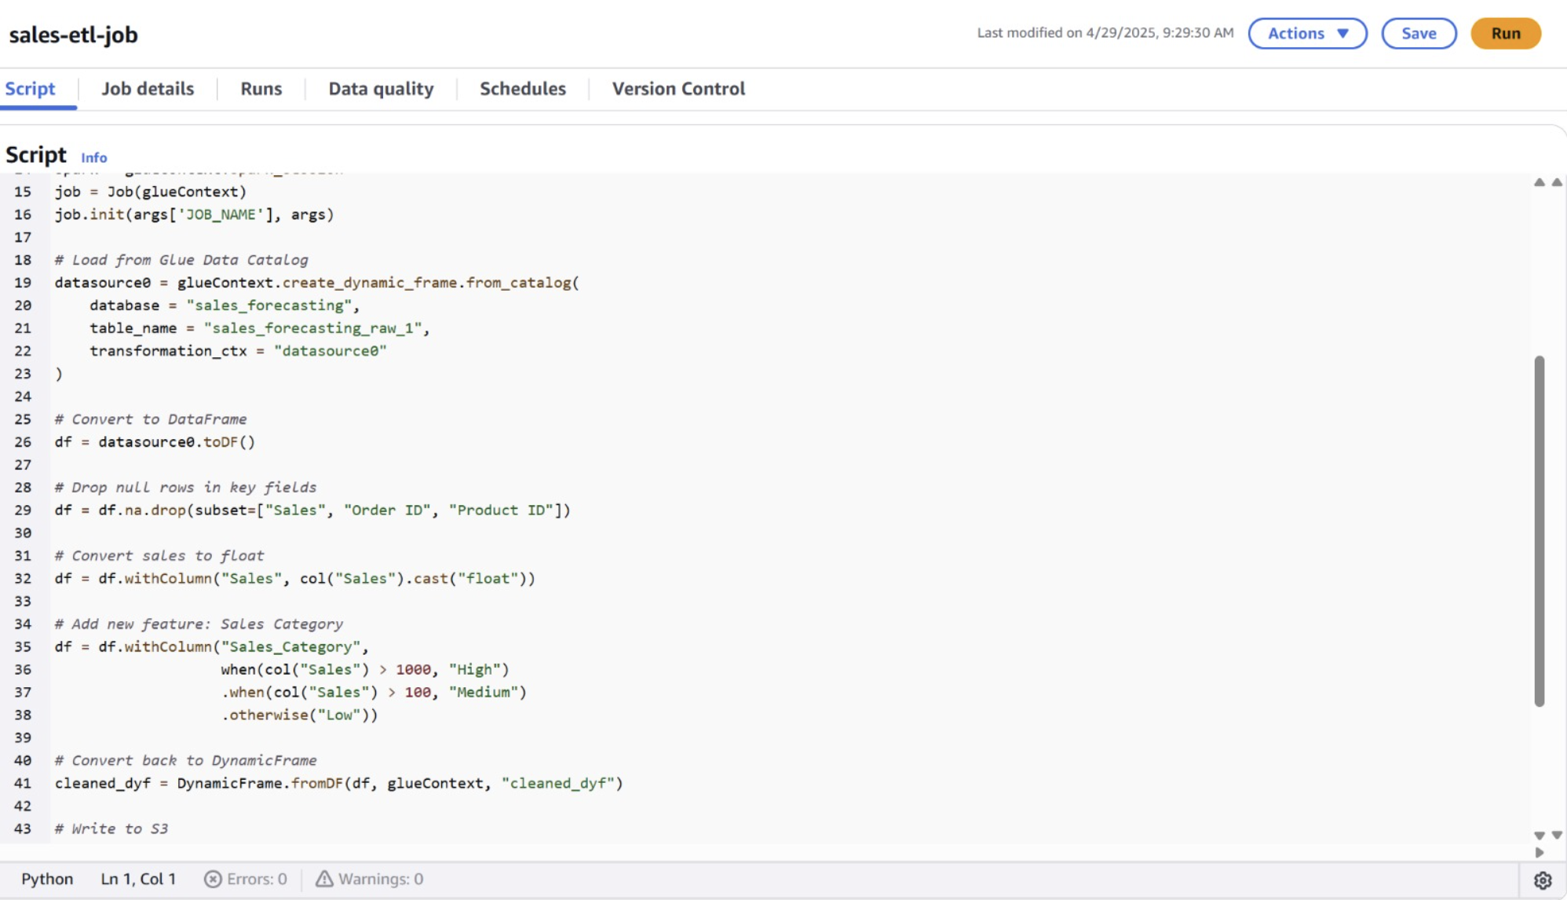
Glue ETL Job

Slide 12
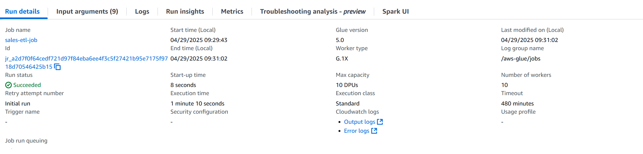
ETL Job Successful

Slide 13
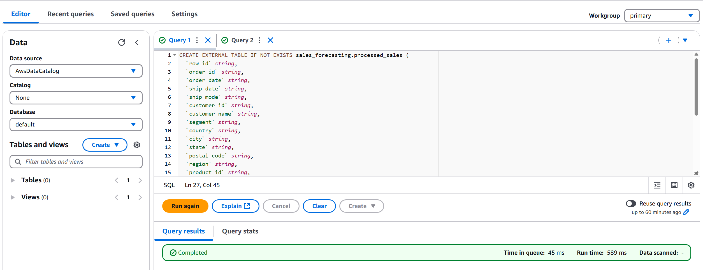
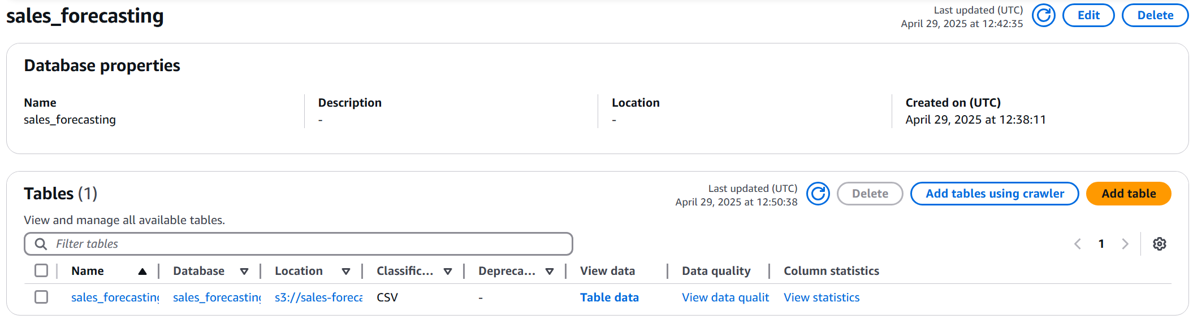
Athena Query to create Table

Slide 14
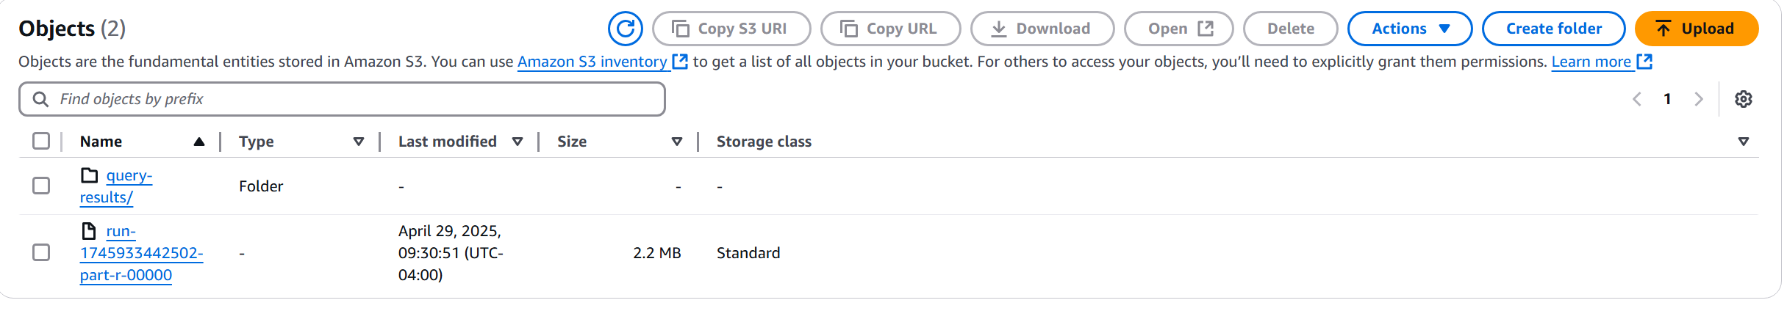
Processed Data

Slide 15
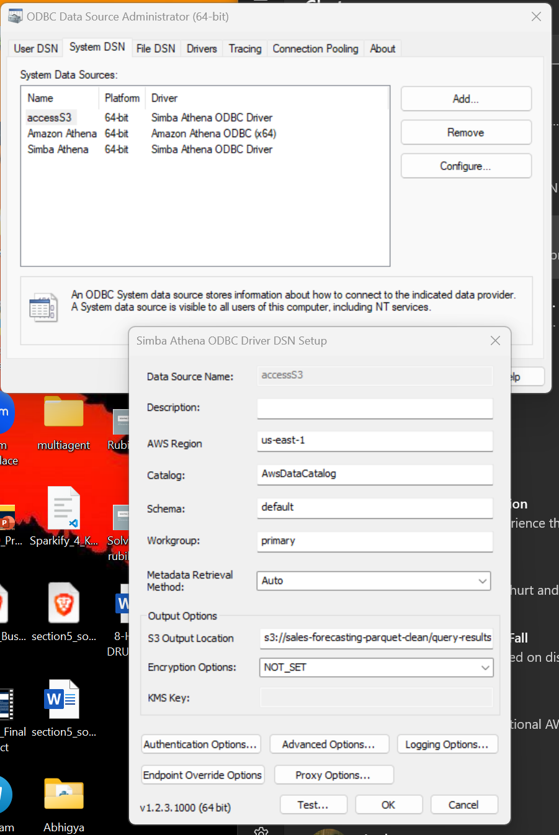
ODBC Configuration

Slide 16
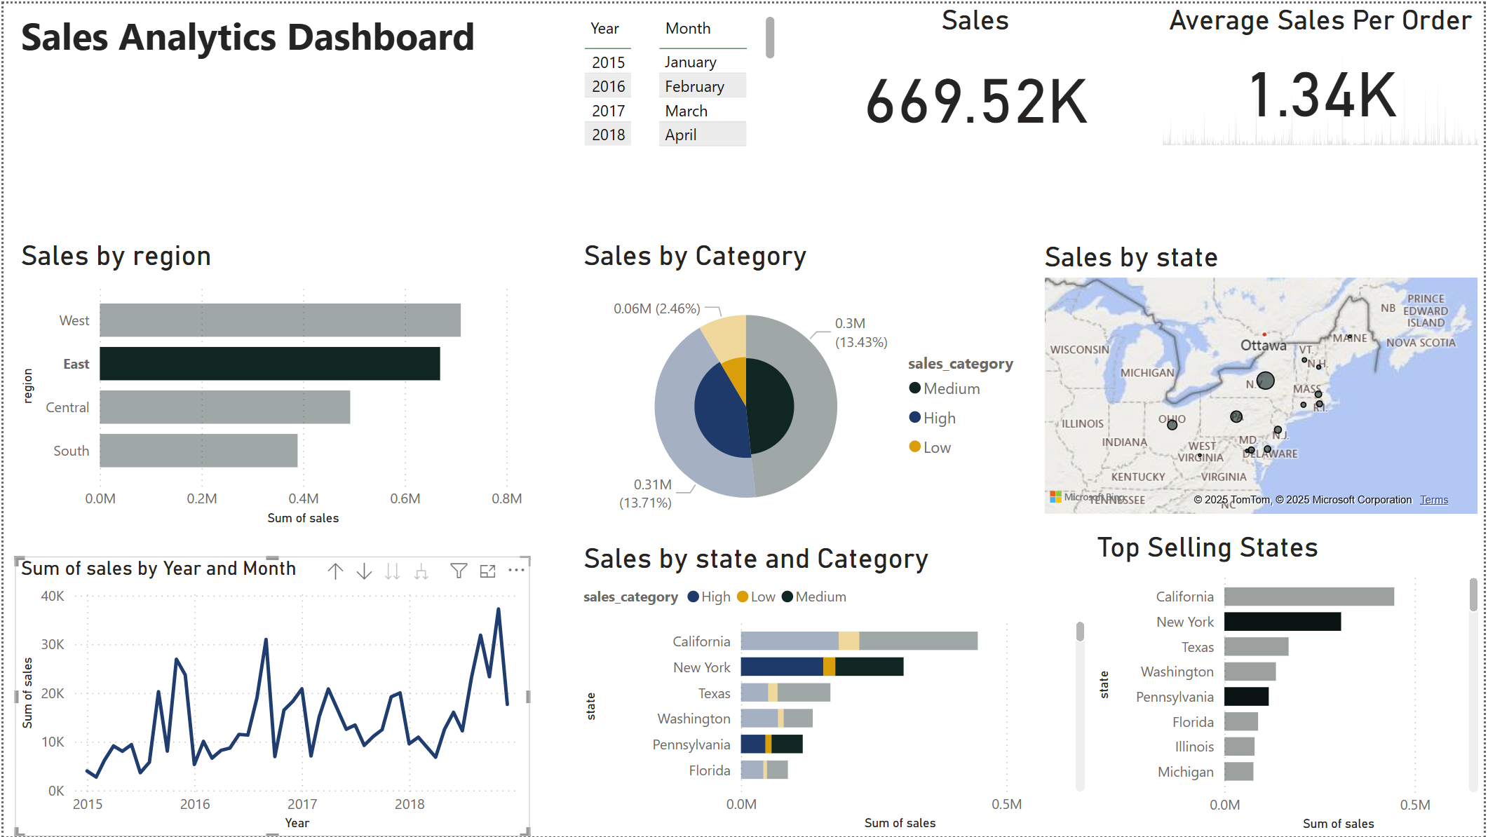
Dashboard Visualization on Power BI

Slide 17
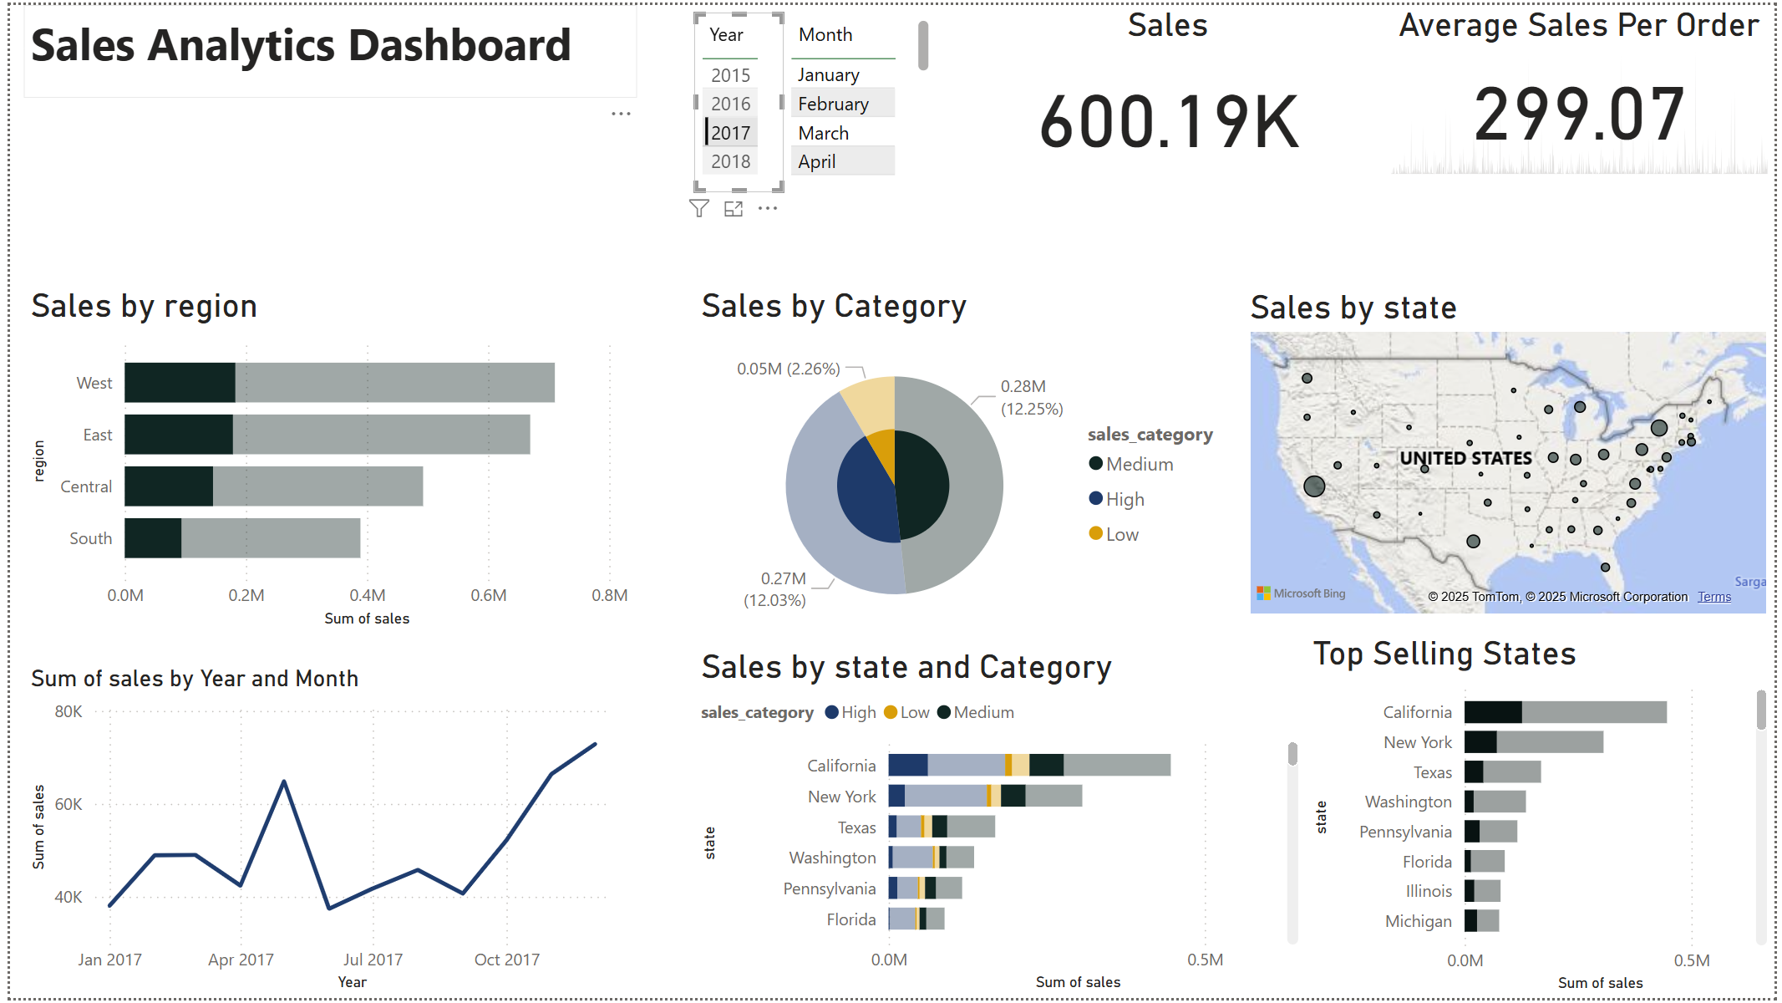
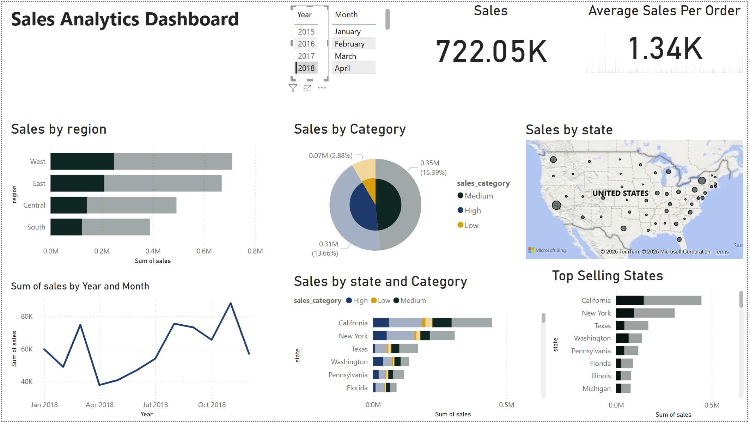
Sales Analysis of 2017 & 2018

Slide 18
Thank you

